Slide 1
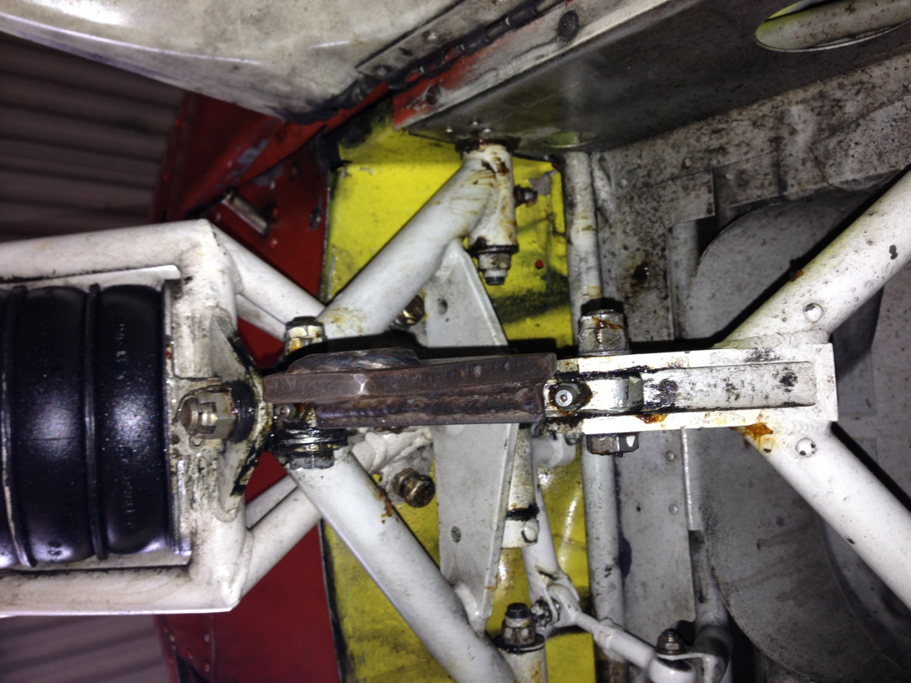
Rigging tool in place as viewed from behind the nose gear.
Nose Gear

Slide 2
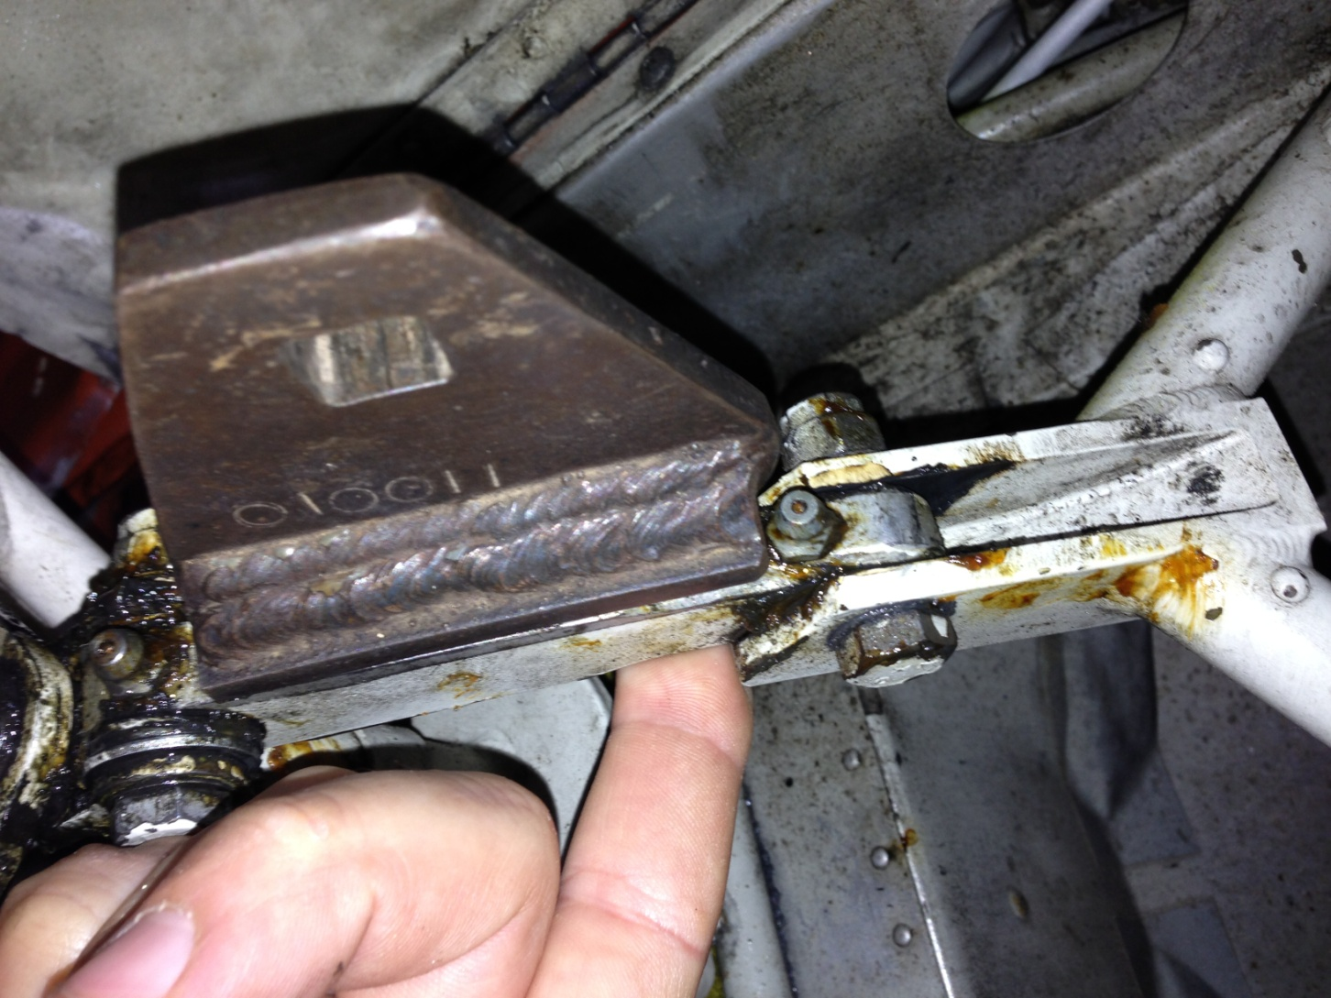
Hinge point
Nose Gear

Slide 3
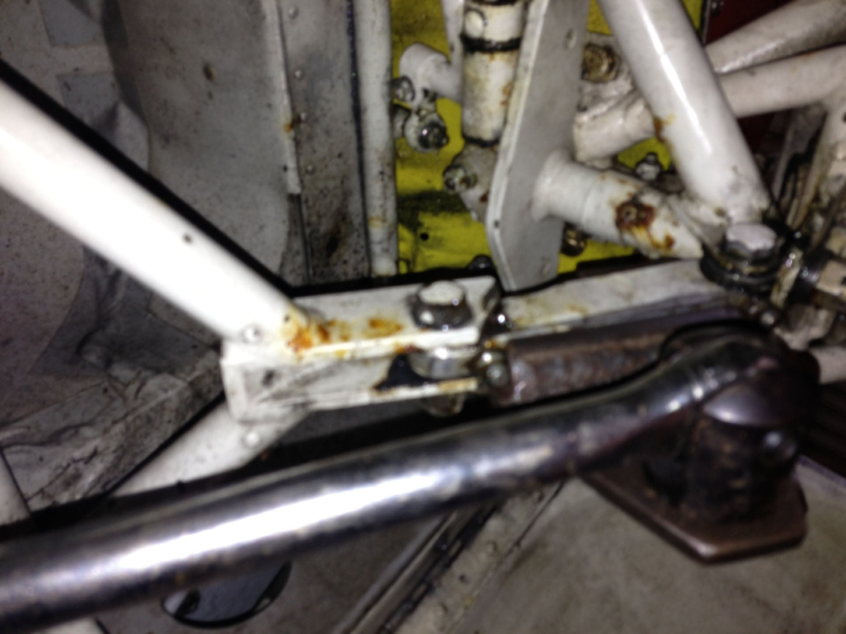
Rigging tool and Wrench. Arrow shows direction of travel.
Nose Gear

Slide 4
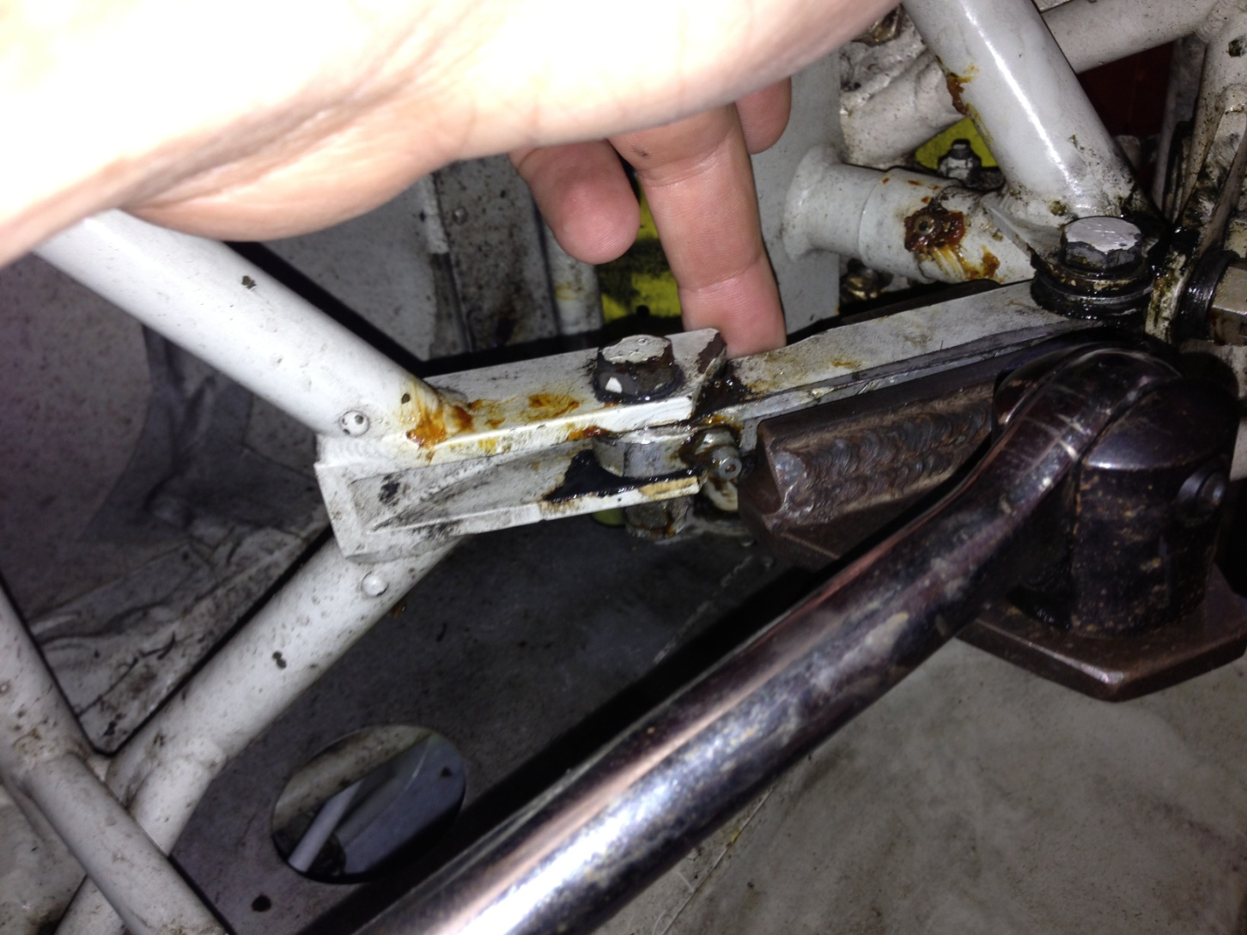
Rigging tool in place arrows show orientation of wrench and direction of torque. Feel with finger for the slightest break at the hinge and read torque at that point.
Nose Gear

Slide 5
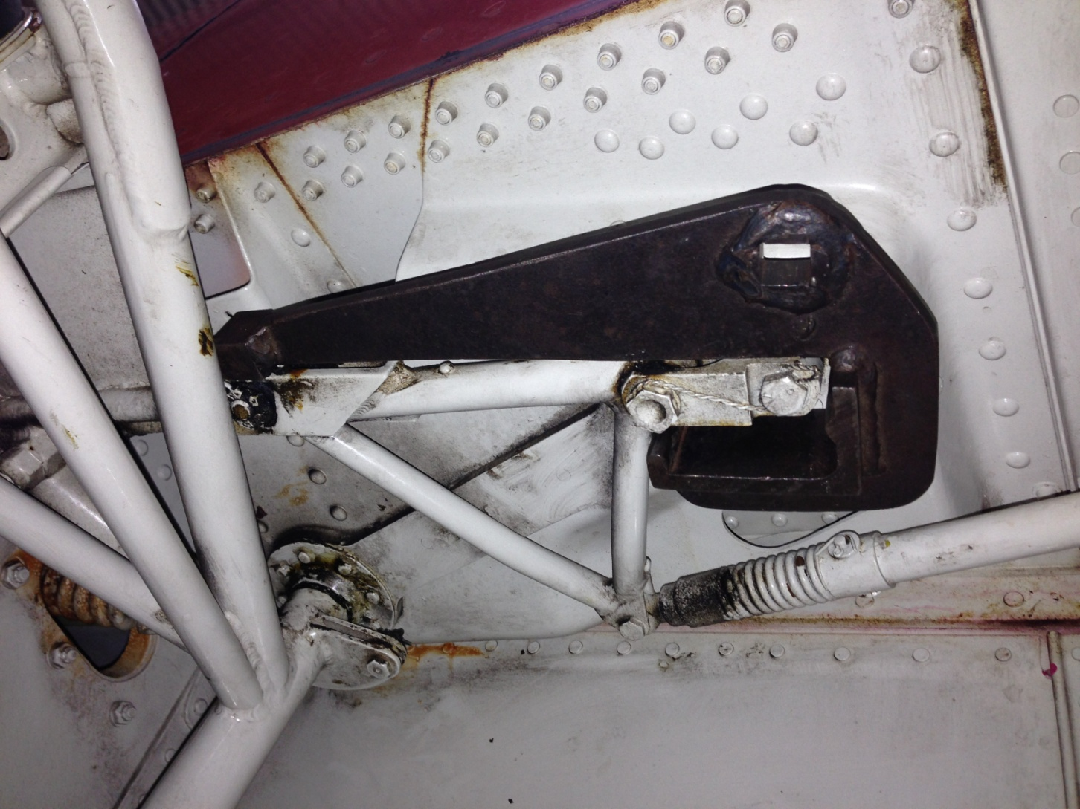
Properly oriented rigging tool viewed from the perspective of lying on ones back.
Main Gear

Slide 6
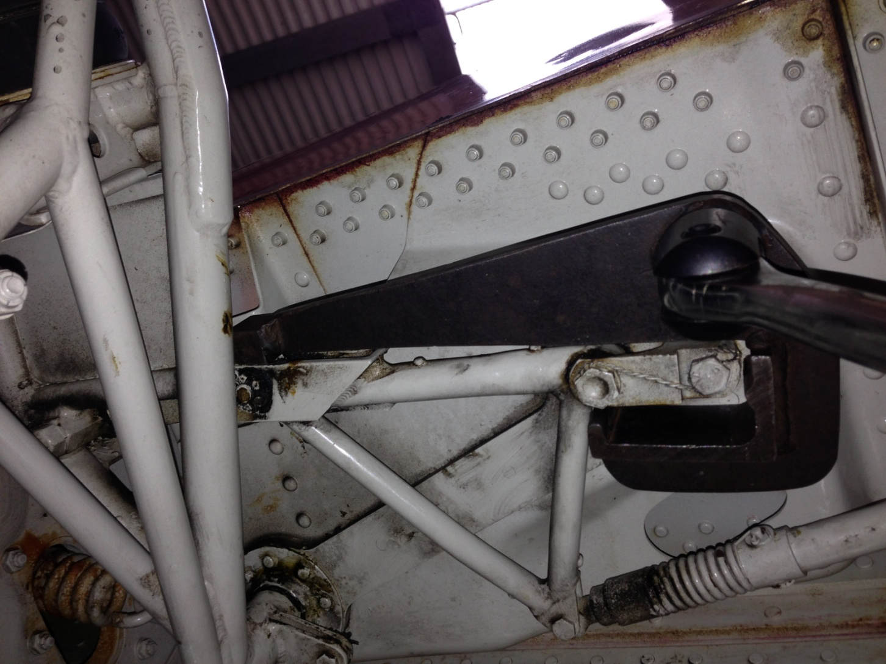
Rigging tool with wrench in place to show torque wrench orientation.
Main Gear

Slide 7
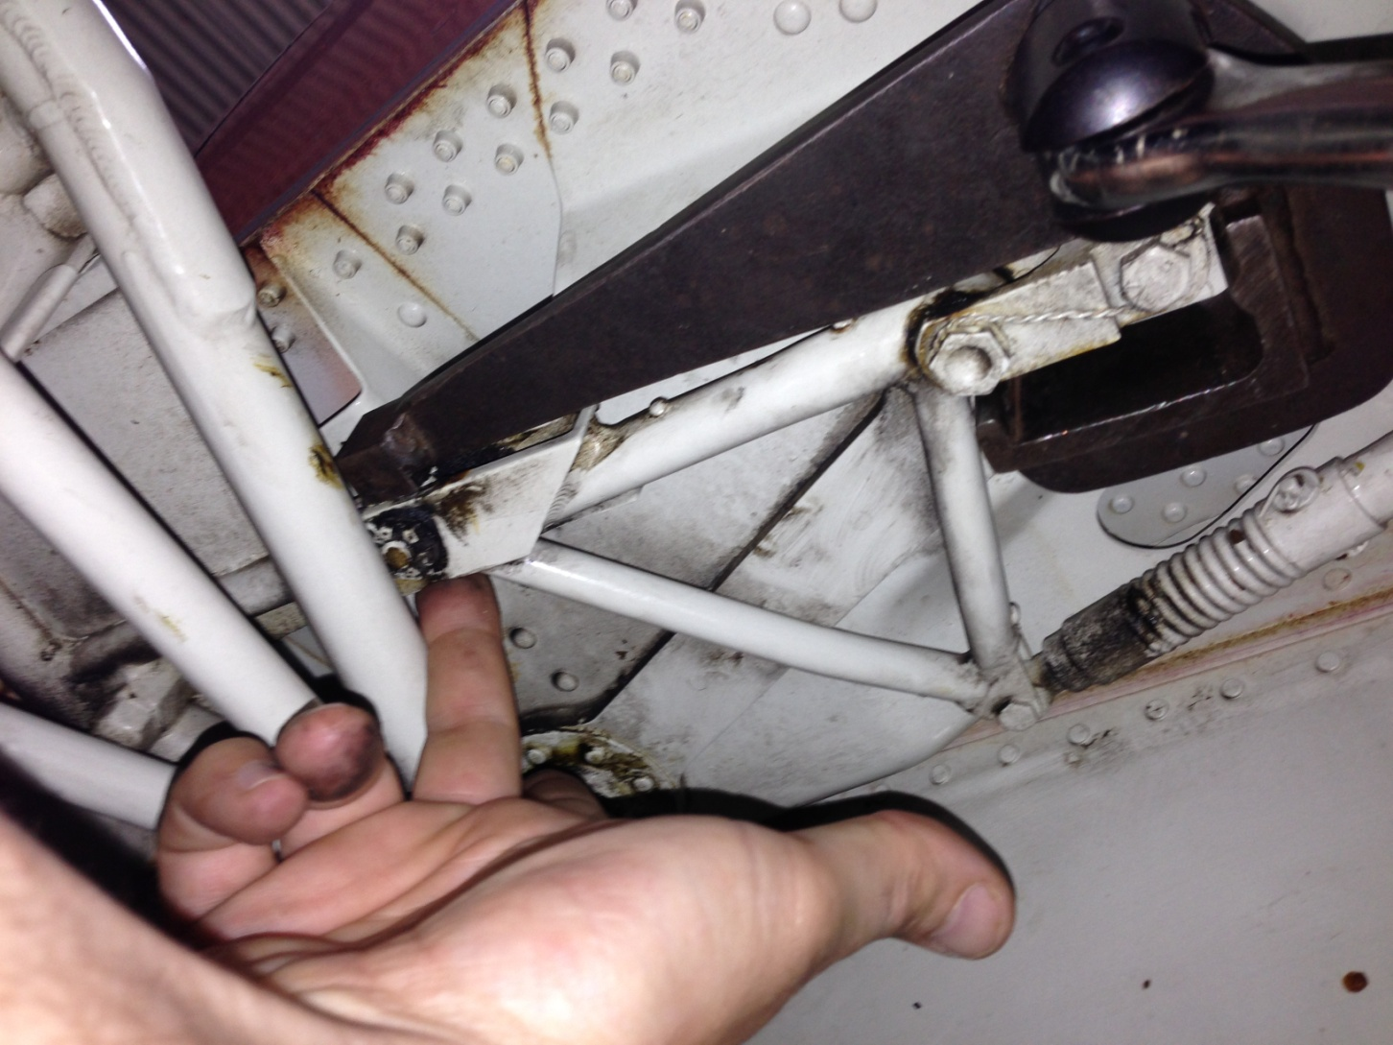
Apply torque so that the rigging tool actuates the hinge in the direction of the arrow
Read the torque at the slightest perception of movement.
Main Gear

